Slide 1
CSE 12 Week 5 Discussion
4-30-21
Focus: PA5, Sorting, Partition, Using Code on Internet

Slide 2
Reminders
PA5 is a closed assignment - no collaborating!
PA2 Resubmission due TODAY (Friday, April 30th) at 11:59 PM
PA3 Resubmission due next week (Friday, May 7th) at 11:59 PM

Slide 3
PA5 Overview
You will be implementing 3 methods in PartitionOracle.java
findCounterExample
generateInput
isValidPartitionResult
Writing your own tests in TestPartitionOracle.java
Writing 2 different Partitioners
FirstElePivotPartitioner.java
CentralPivotPartitioner.java
Copying an implementation of partition online (when allowed) and adapt it to a Partitioner in WebPartitioner.java
Tips: The autograder on Gradescope is very slow, so test locally. Do not use Gradescope as a debugger!

Slide 4
Best case vs. Worst case Runtime
Common Misconception: The best case time complexity for this sorting algorithm is O(1) because in the best case the array only has one element
Why this is not right: When we say “best case” or “worst case”, it is with respect to n, which is the size of the data. When an array only has one element, n = 1, so if this algorithm has a time complexity of O(n^2) on any array, its time complexity on an array of 1 will still be O(n^2). Hence, O(1) describes an algorithm whose runtime is independent of the size of the input data.

Slide 5
Best case vs. Worst case Runtime
In the context of sorting:
Best case and worst case happen when the order of values in the array happen to make this algorithm run the fastest/slowest compared to when the input array is any other array of the same size.
E.g. Let’s say we have a group of sorted arrays and a group of unsorted arrays of the same size. If the sorting algorithm generally runs faster on the group of sorted arrays, we can say that the best case for this algorithm is when the input array is sorted

Slide 6
Average Case Runtime
The performance of the algorithm on an “average” array of size n
Imagine we have a set of all possible input data, and we randomly select some out of this set and measure the average runtime of the algorithm on those selected data
Sometimes you will see this term alongside “best case” and “worst case”
Hard to prove but sometimes make sense intuitively

Slide 7
Sorting

Slide 8
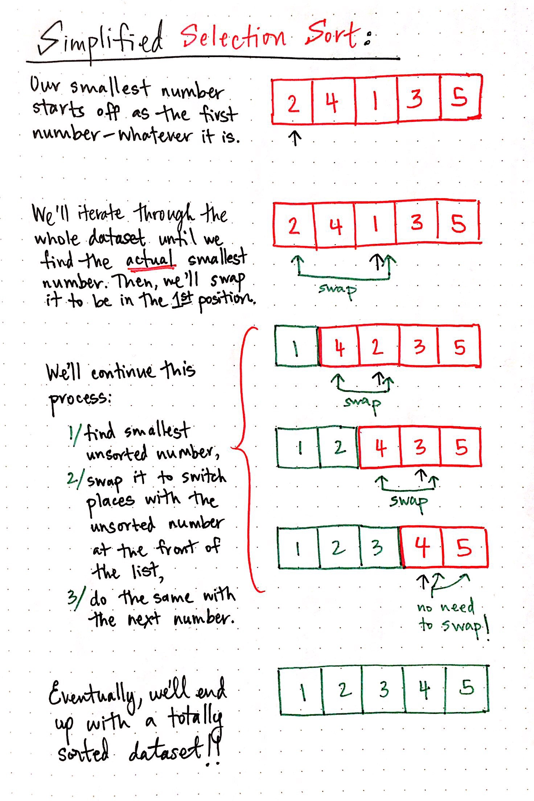
Selection sort

Slide 9
Selection sort
public static void sSort(int[] arr) {
for(int i = 0; i < arr.length - 1; i += 1) {
System.out.print(Arrays.toString(arr) + " -> ");
int minIndex = i;
for(int j = i; j < arr.length; j += 1) {
if(arr[minIndex] > arr[j]) { minIndex = j; }
}
int temp = arr[i];
arr[i] = arr[minIndex];
arr[minIndex] = temp;
System.out.println(Arrays.toString(arr));
}
}
What is the worst case runtime for selection sort?
O(n^2)
O(n)
O(nlogn)
o(n!)
None of the above

Slide 10
Answer - A
public static void sSort(int[] arr) {
for(int i = 0; i < arr.length - 1; i += 1) {
System.out.print(Arrays.toString(arr) + " -> ");
int minIndex = i;
for(int j = i; j < arr.length; j += 1) {
if(arr[minIndex] > arr[j]) { minIndex = j; }
}
int temp = arr[i];
arr[i] = arr[minIndex];
arr[minIndex] = temp;
System.out.println(Arrays.toString(arr));
}
}
n + (n - 1) + … + 2 = (n + 2) * (n - 1) / 2 = O(n^2)

Slide 11
Selection sort
public static void sSort(int[] arr) {
for(int i = 0; i < arr.length - 1; i += 1) {
System.out.print(Arrays.toString(arr) + " -> ");
int minIndex = i;
for(int j = i; j < arr.length; j += 1) {
if(arr[minIndex] > arr[j]) { minIndex = j; }
}
int temp = arr[i];
arr[i] = arr[minIndex];
arr[minIndex] = temp;
System.out.println(Arrays.toString(arr));
}
}
What is the best case runtime for selection sort?
O(n^2)
O(n)
O(nlogn)
O(n!)
None of the above

Slide 12
Answer - A
public static void sSort(int[] arr) {
for(int i = 0; i < arr.length - 1; i += 1) {
System.out.print(Arrays.toString(arr) + " -> ");
int minIndex = i;
for(int j = i; j < arr.length; j += 1) {
if(arr[minIndex] > arr[j]) { minIndex = j; }
}
int temp = arr[i];
arr[i] = arr[minIndex];
arr[minIndex] = temp;
System.out.println(Arrays.toString(arr));
}
}
Even in best case, outer loop runs through all iterations while going through entire inner loop each time
So it’s still O(n^2)

Slide 13
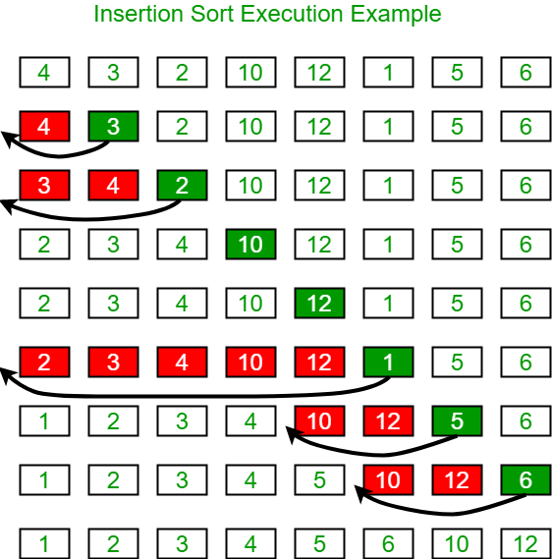
Insertion sort

Slide 14
Insertion sort
public static void iSort(int[] arr) {
for(int i = 0; i < arr.length; i += 1) {
System.out.print(Arrays.toString(arr) + " -> ");
for(int j = i; j > 0; j -= 1) {
if(arr[j] < arr[j-1]) {
int temp = arr[j-1];
arr[j-1] = arr[j];
arr[j] = temp;
}
else {
break;
}
}
System.out.println(Arrays.toString(arr));
}
}
What is the worst case runtime of insertion sort?
O(n^2)
O(n)
O(nlogn)
O(n!)
None of the above

Slide 15
Answer - A
public static void iSort(int[] arr) {
for(int i = 0; i < arr.length; i += 1) {
System.out.print(Arrays.toString(arr) + " -> ");
for(int j = i; j > 0; j -= 1) {
if(arr[j] < arr[j-1]) {
int temp = arr[j-1];
arr[j-1] = arr[j];
arr[j] = temp;
}
else {
break;
}
}
System.out.println(Arrays.toString(arr));
}
}
Will not call break statement in worst case because entire list is out of order
1 + 2 + … + (n - 1) = (1 + (n - 1)) * (n - 1) / 2 = O(n^2)

Slide 16
Insertion sort
public static void iSort(int[] arr) {
for(int i = 0; i < arr.length; i += 1) {
System.out.print(Arrays.toString(arr) + " -> ");
for(int j = i; j > 0; j -= 1) {
if(arr[j] < arr[j-1]) {
int temp = arr[j-1];
arr[j-1] = arr[j];
arr[j] = temp;
}
else {
break;
}
}
System.out.println(Arrays.toString(arr));
}
}
What is the best case runtime of insertion sort?
O(n^2)
O(n)
O(nlogn)
O(n!)
None of the above

Slide 17
Answer - B
public static void iSort(int[] arr) {
for(int i = 0; i < arr.length; i += 1) {
System.out.print(Arrays.toString(arr) + " -> ");
for(int j = i; j > 0; j -= 1) {
if(arr[j] < arr[j-1]) {
int temp = arr[j-1];
arr[j-1] = arr[j];
arr[j] = temp;
}
else {
break;
}
}
System.out.println(Arrays.toString(arr));
}
}
Best case: sorted list
As a result, will call break statement each time inner loop is entered
Inner loop runs O(1)
Outer loop still runs O(n)
O(n) * O(1) = O(n)

Slide 18
Quicksort Summary
Pick a pivot
This can be the first element, last element, middle element etc. (Needs to be consistent though)
Partition around the pivot
Repeat with the subarrays determined by the pivot

Slide 19
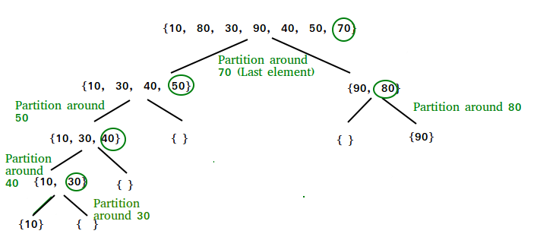
Graphic visualization of quicksort
Resultant single-element arrays to combine: {{10}, {30}, {40}, {50}, {70}, {80}, {90}}

Slide 20
Partition

Slide 21
public int partition(String[] array, int low, int high) {
if(low == high) { return low; }
int pivotIndex = high - 1;
String pivot = array[pivotIndex];
int smallerBeforeIndex = low;
int largerAfterIndex = high - 2;
while(largerAfterIndex >= smallerBeforeIndex) {
if(Integer.parseInt(array[smallerBeforeIndex]) >
Integer.parseInt(pivot)) {
swap(array, smallerBeforeIndex, largerAfterIndex);
largerAfterIndex -= 1;
} else {
smallerBeforeIndex += 1;
}
}
if(Integer.parseInt(array[smallerBeforeIndex]) < Integer.parseInt(pivot)){
swap(array, smallerBeforeIndex + 1, pivotIndex);
return smallerBeforeIndex + 1;
} else{
swap(array, smallerBeforeIndex, pivotIndex);
return smallerBeforeIndex;
}
}

Slide 22
How can we test any partition?
Direct unit testing is not always possible. For example, if we step through our own partition algorithm, we know what exact array it should output, and we can use assertArrayEquals to compare the returned array and what we expect. But, different partitioners could return different arrays that are still valid partitions! In this case, we want to test for a valid partition by testing whether or not the array produced matches with our general constraints: all elements from before are still present, the array length hasn’t changed, all elements to the left of the pivot index are less than or equal to the pivot value, and all elements to the right of the pivot index are greater than or equal to the pivot value

Slide 23
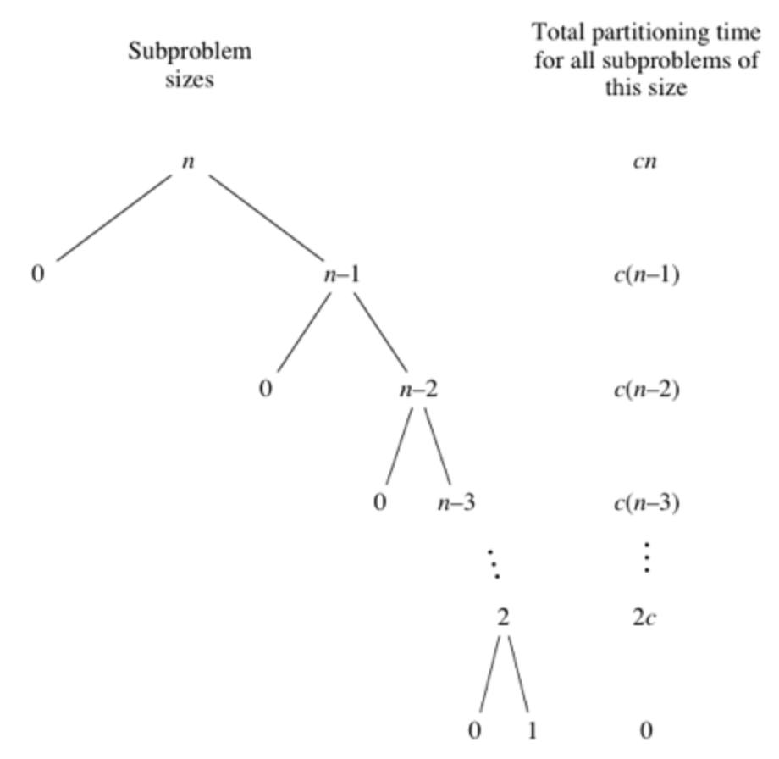
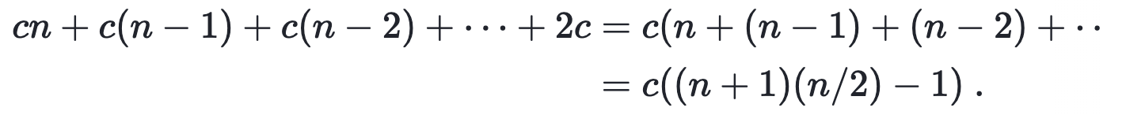
Quicksort Worst Case
O(n^2)
O(n)
O(nlogn)
O(n!)
None of the above

Slide 24
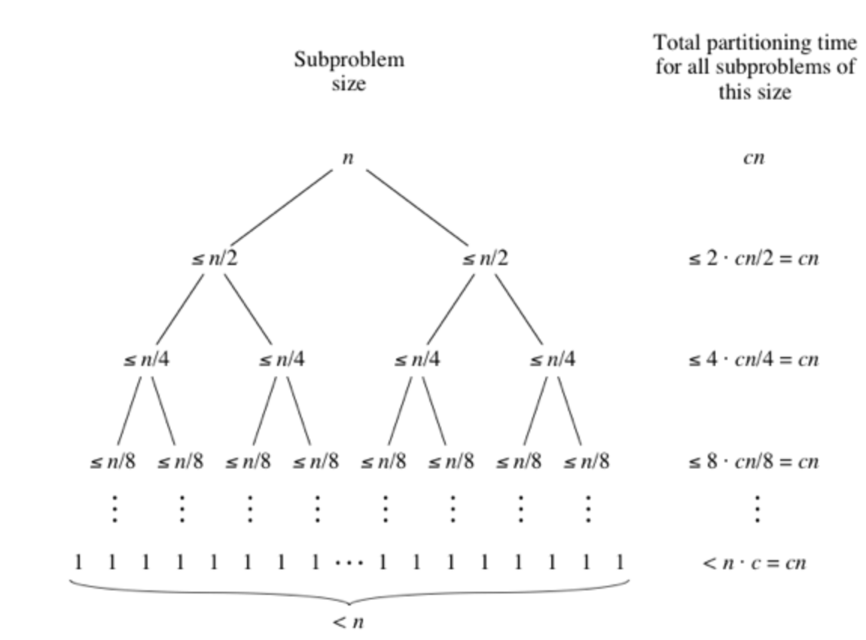

Quicksort Best Case
O(n^2)
O(n)
O(nlogn)
O(n!)
None of the above
logn levels

Slide 25
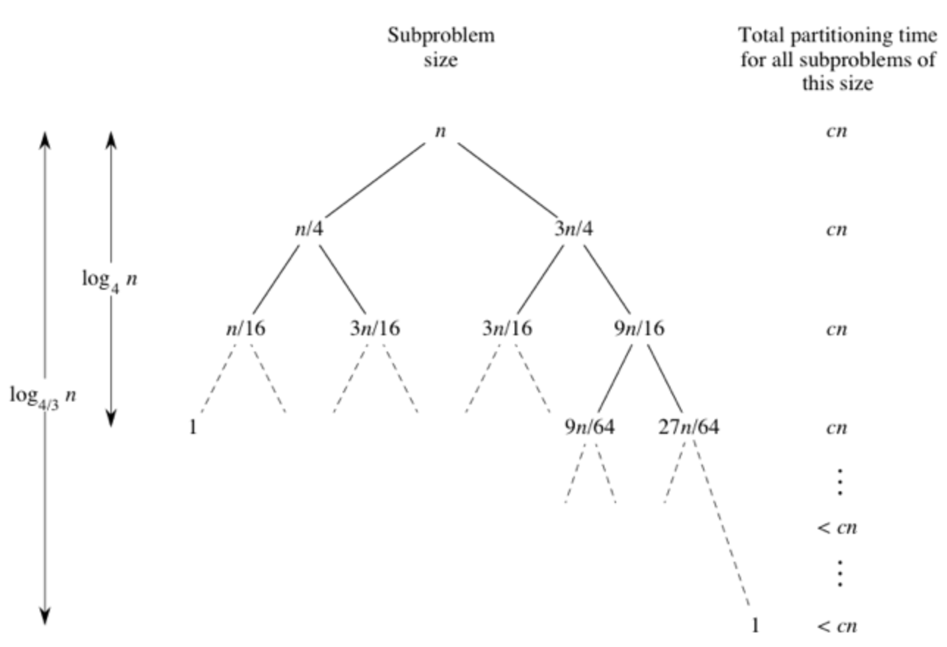
Quicksort Average Case
Hard to prove but we can still make sense of it from an example.
Runtime: O(nlogn)
Note: in a coding interview, if you used a built-in sorting method for some programming language, we assume that its tight big-O bound is O(nlogn)

Slide 26
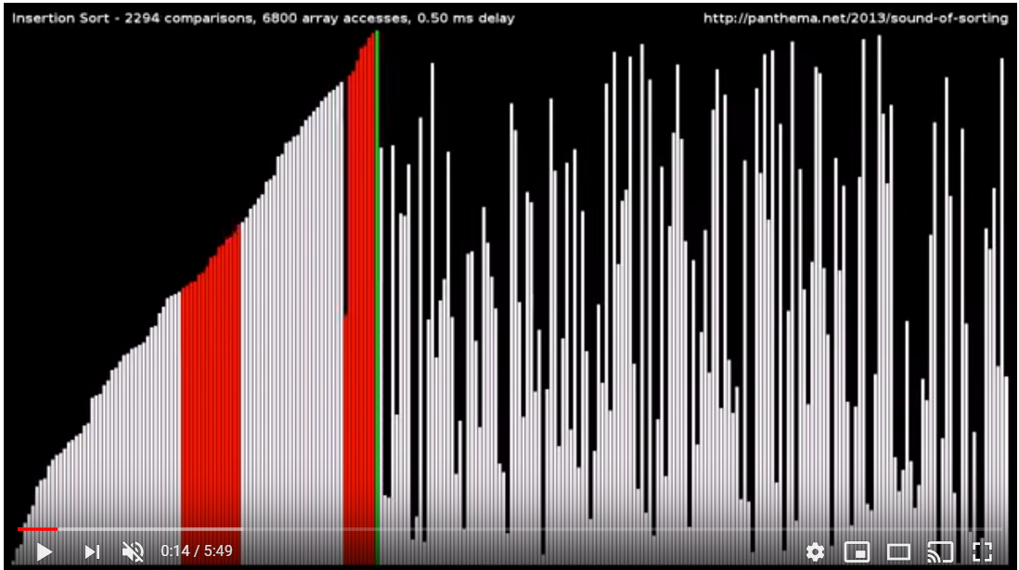
Sorting Algorithm Visualizations
WARNING: flashing lights
https://www.youtube.com/watch?v=kPRA0W1kECg
If you do not have a hearing sensitivity, we recommend having the volume on during these visualizations. Lower pitches correspond to operations on smaller bars/values, and higher pitches correspond to operations on larger bars/values. Check out the top left corner for the current sort method and number of certain operations.
The first 4 sort methods are the 4 you’ve learned so far: insertion, selection, quick, and merge sort.
Note on bogo sort: this is a bit of a joke in CS. Bogo sort works by randomly moving all of the values until it finds the sorted solution by chance; it is the last sort method in the video. It has run time upper bound: O((n+1)!)

Slide 27
Using Code from Internet

Slide 28
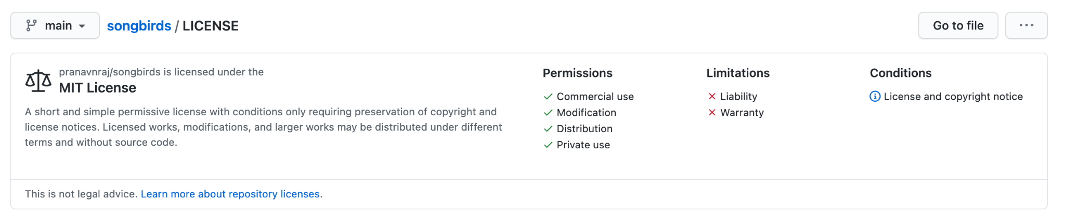

Licenses

Slide 29
Where to look
GitHub: Some repositories have a file named LICENSE or LICENSE.txt in them that specifies the allowed usage of their code. If a repo doesn’t contain a LICENSE file, don’t use it!
Stack Overflow: See https://stackoverflow.com/help/licensing for license of publicly available user answers
Any other website that has a license or a terms of service that specifies the legal usage of their code

Slide 30
Link to Google Slide
https://docs.google.com/presentation/d/1h5ou2JO-jVzELldhID0rV1Es62lJLerfIu-aIlpNYCo/edit?usp=sharing

